Slide 2
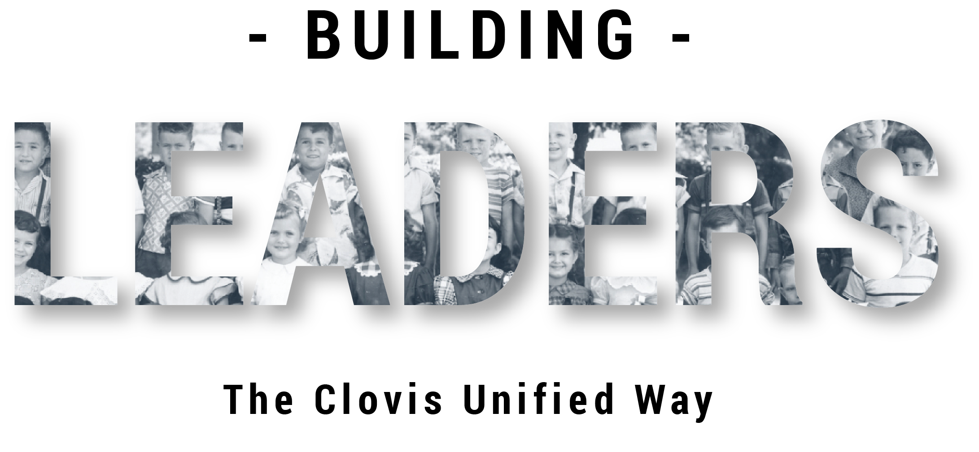
Hiring is the Most Important Thing We Do
Notes:
Facilitator:
If this is the first-time participants are hearing about the Doc B Leadership Academy introduce the Academy. This is a great opportunity to build the “why” behind the “what” of leadership development based on the philosophies and values of Clovis Unified (script available in resource folder). If this is not the first time briefly review the purpose of the Leadership Academy.

Slide 3
Hiring is the most important thing we do.
Doc’s Charge
We believe in high standards in Clovis schools. We believe competition is an ingredient of high standards and an important motivational tool. We recognize three levels of competition. First, we want you to make sure that all of our students learn to compete against themselves; that’s the toughest competition of all. Second, we want you to encourage our students to compete in specialty areas to help them build on their strengths and overcome their weaknesses, because that’s the way they get jobs and that’s the way they have to perform in life. Third, we want to you to teach our students to work in groups and to compete in groups because we think that students who can’t work in groups are going to have trouble in tomorrow’s world.
Competition does not start with schooling. Competition starts with little children just wanting to play – to catch or hit or kick a ball. Eventually, they learn a few skills and all of a sudden one of them looks at the others and says hey, let’s keep score. Now they’re interested in winning and losing, which is mostly what life’s all about.
While you are working with our children in Clovis we want you to remember the heart of the Clovis program: We want you to teach students to win with class and to lose with dignity. But we also want you to teach them that there is a lot more to being a winner than the final game score. We want you to teach them to root for their team to win, not for their other team to lose. We want you to teach our kids what to do when they lose. We want you to get them off their duffs and get them back in the fight. Don’t you let them give up. And if we can teach them not to be quitters by the time they finish the twelfth grade in the Clovis schools, they will probably make it through life.
Our philosophy is very simple: A fair break for every kid. We believe the schools and the students belong to the people. If our community wants their children to read, write, do arithmetic, sing, dance, play in the band, or compete in forensics – whatever our community wants, we are going to do – but we’re going to do it first class.
Values
“If you want to develop winners, surround our kids with winners.” Doc
You are who you hire.
We look for people a cut above the average.
We hire role models reflective of our student community.
A CUSD leader hires the people who meet the needs of the school site/department, then is held accountable for that hire.
Notes:
Script: Tier I, II, III
Facilitator:
Today, we are going to be looking at the philosophy hiring is the most important thing we do and the critical role it plays in preserving a high-quality educational team that best serves students. There are five values that further articulate the importance of our hiring philosophy. Each value will be discussed during our time together. Facilitator may read, popcorn read, or ask a participant to read the values on the screen.
Values
“If you want to develop winners, surround our kids with winners” is a value statement we attribute to Doc Buchanan. The other four values are based on the collaborative effort of employees and reviewed annually as part of our strategic plan.
You are who you hire.
We look for people a cut above the average.
We hire role models reflective of our student community.
A Clovis Unified leader hires the people who meet the needs of the school site/department, then is held accountable for that hire.
Ask participants to turn to a neighbor and share one value that resonates with them and explain why. Allow five minutes for sharing (facilitator’s choice).
Ask for volunteers to share the value they selected and why.
Facilitator models, sharing their choice and why.
As you read each value ask for a show of hands as to who selected it (just a point of interest). Facilitator can comment on which value was selected most often.

Slide 4
“In Clovis, we still like children.” Doc’s Charge
We make no bones about it. We’ve got a Clovis image to keep up, and we’re looking for people a cut above the average. We’re concerned about your appearance, your attitude, your teaching skills, your ability to work with students, but most of all we’re concerned about your character and your values. You are going to be around our children when nobody else is there.
Link: Tracy Smith Reading Doc’s Charge
Notes:
https://vimeo.com/838099330/ac76b8860c
Script: Tier I, II, III
Facilitator:
During interviews we asked participants to read one of the favorite portions of Doc’s Charge. Today we are listening to Dr. Tracy Smith. Tracy was a longtime administrator in CUSD. She was the first principal of Woods Elementary School. Some of you may have been one of Tracy’s students as she taught courses at California State University, Fresno. Let’s watch Tracy as she reads…
As an individual think about the statement “In Clovis, we still like children.” What does this statement mean to you? What do you see our employees doing that demonstrates “We still like children”?
Ask volunteers to share their thoughts. Once complete begin discussion points.
Discussion Points:
In small job alike groups ask participants to discuss one or more of the following:
101 – Let’s examine the section of Doc’s Charge on the screen. How does this come into play during the hiring process?
201 – How has the hiring process evolved over the past 60 years?
301 – Describe the characteristics we want in a teacher/employee today. What are the consequences of choosing to hire someone who does not exemplify the Clovis Unified standard?
After everyone is done ask each group to share one of their examples.

Slide 5
If you are still interested in working in Clovis… Doc’s Charge
“we’d like to offer you a contract. We people in Clovis get excited when teachers and students do things nobody thought they could do. As long as you work in Clovis don’t you ever lose that spirit… and never forget our motto, Sic’em!”
Notes:
Script: Tier I, II, III
Ask participants to read the excerpt from Doc’s Charge. Popcorn read, read altogether, or facilitator may read.
Facilitator:
As an individual think about the statement “as long as you work in Clovis don’t you ever lose that spirit ....and never forget our motto, “Sic ‘em!” What does this statement mean to you? What do you see our employees doing and saying that demonstrates they still have the spirit Doc talks about? Turn to your neighbor and share your thoughts. Ask for volunteers to share out.
Discussion Points:
In small job alike groups ask participants to look at bolded statement to discuss. They should come to consensus on why it is important to maintaining the quality of CUSD. Then discuss one of the following questions.
101 – What did the statement look like when the district unified? How has it changed over the past 60 years?
201 – As a leader at your site/department what characteristics do you model that demonstrate the Sic ‘em attitude?
301 – As a leader it is your responsibility to create an environment that fosters the spirit Doc describes in his Charge. List/discuss three ways you perpetuate that Clovis spirit in your department and/or school site.
After everyone is done ask each group to share one of their examples.

Slide 6
Hiring is the Most Important Thing We Do Video
Notes:
Facilitator:
Depending on your time allocation and the audience you have several options.
The PowerPoint is designed for you to use the slides you choose in any order.

Slide 7
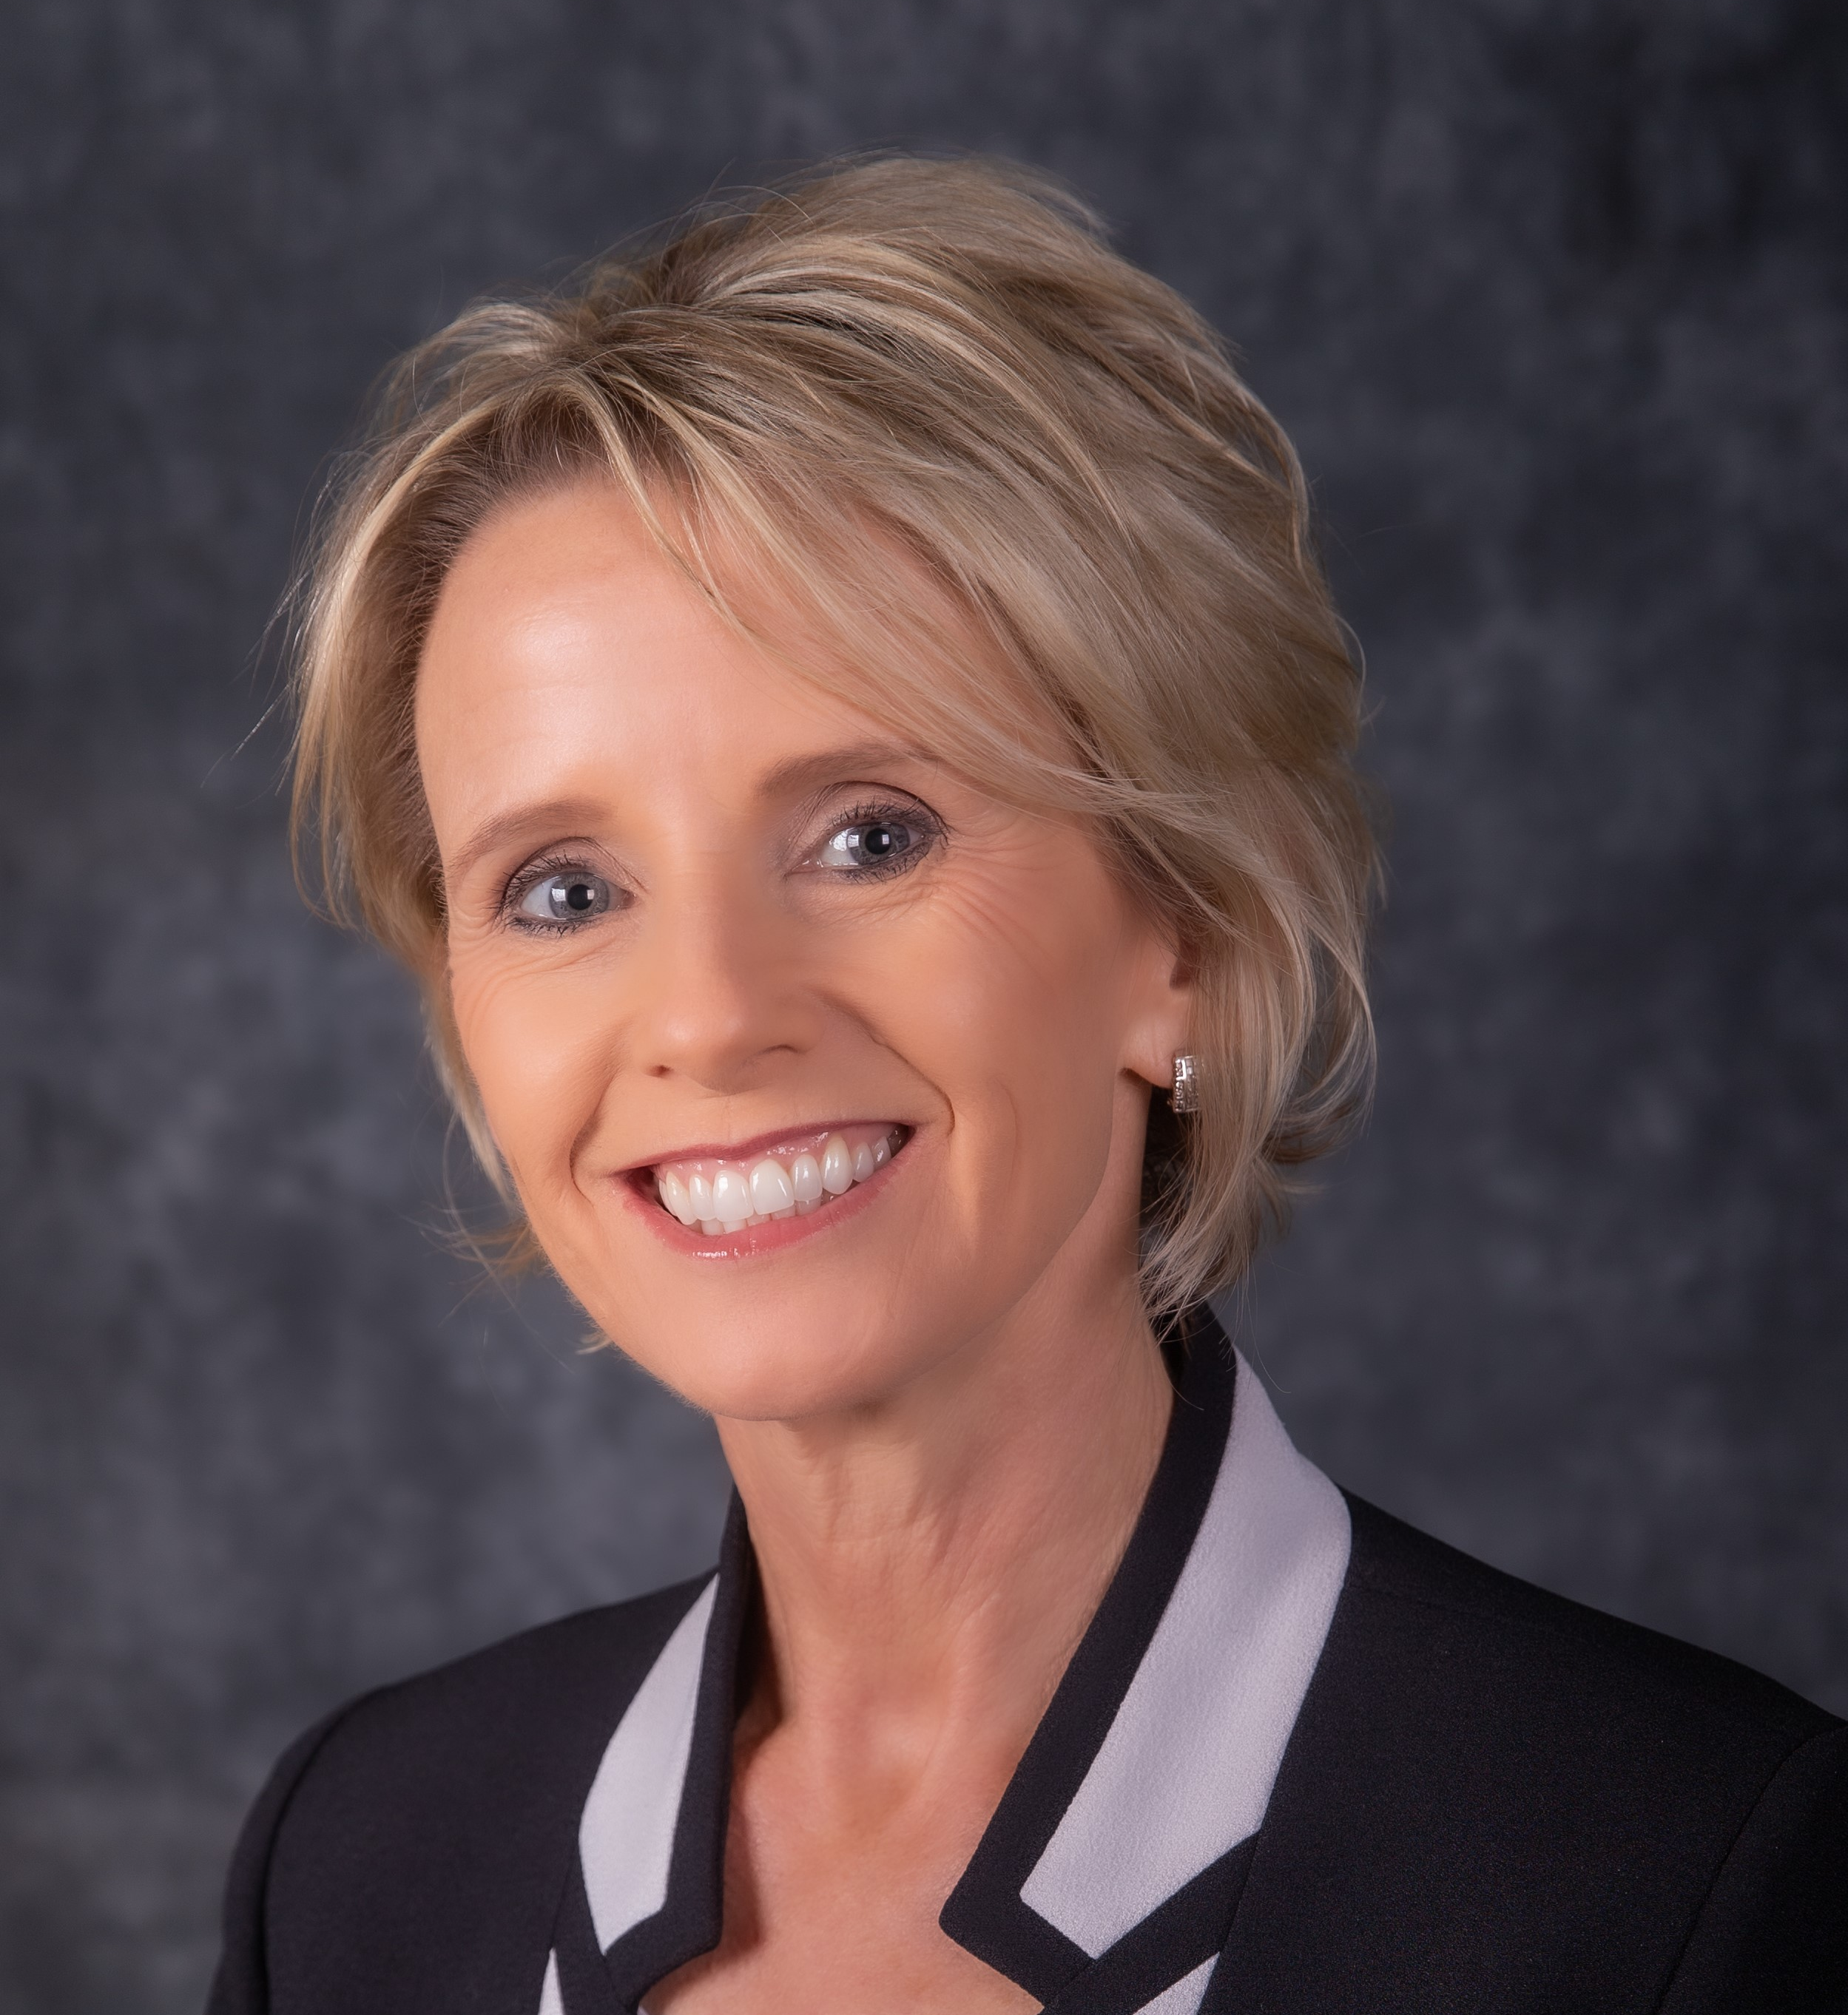
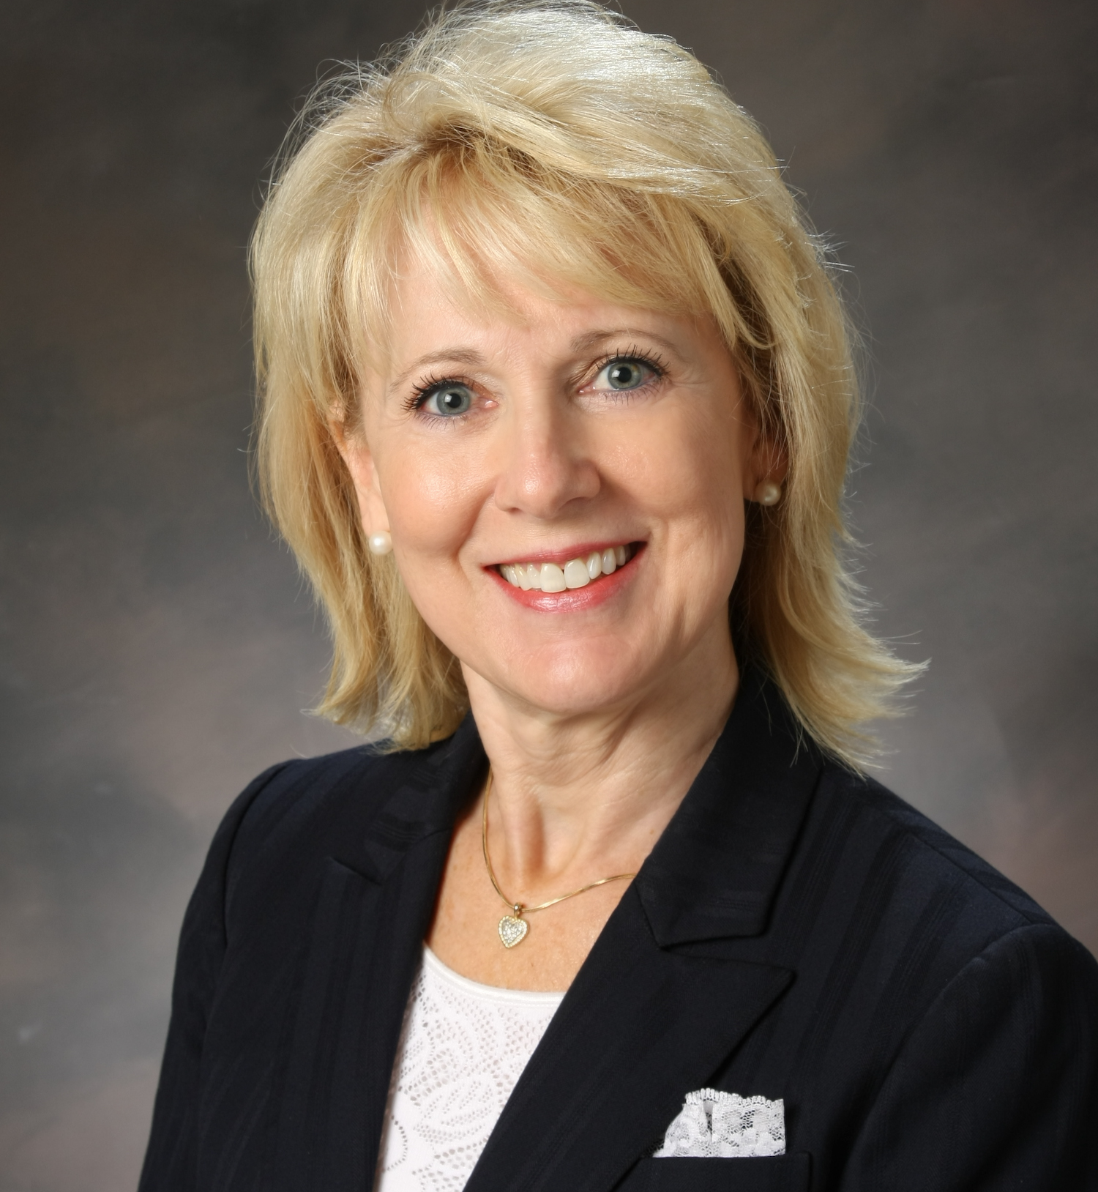
Most of all we are concerned about your character and your values…
How are individuals applying for a position at your school or department vetted during the hiring process?
Eimear O’Brien, Ed.D
Janet Young, Ed.D
Notes:
Script: Tiers I, II, III
Facilitator:
In the video you heard about the hiring process and how every employee goes through multiple interviews before being offered a contract in CUSD. The Superintendent is responsible for each and every hire. Our current Superintendent and all former Superintendents interview all recommended candidates for teaching positions in our district.
Dr. Janet Young talked about looking for the “care chip”. She would say “We can help employees to learn their position, but we can not teach them to care about our students and their colleagues.”
Dr. Eimear O’Brien would say “Right from the get-go, our leaders need to establish with their stakeholders the fact that they really care about our kids and our staff and care about providing the very best educational learning environment for our students.”
In the video you heard Dr. Bradley discusses hiring traditions began by Doc Buchanan and Dr. Buster’s initial impressions and thoughts over time on hiring in CUSD.
Think about how individuals at your site and/or department are vetted during the interview process. Turn to a partner and share the process for your site/department.
Ask for volunteers to share key take-aways.

Slide 8
End of Part I
Notes:
Facilitator:
Depending on your time allocation and the audience you have several options.
The PowerPoint is designed for you to use the slides you choose in any order.

